Slide 1
Supporting Your Childs Mental Health A Guide for Parents Debbie Drane – Assistant Headteacher – January 2020

Slide 2
Marshfields School – Positive Mental Health Policy

Slide 3
Affects of pandemic on our mental health
Social distancing
Lockdown(s)
Illness
Loss of loved ones
Over consumption of stress through media coverage
Boredom / social isolation
Anxiety about catching the virus
Disproportionate affects for many people, including those with learning difficulties / disabilities
More than half of adults and over two thirds of young people said that their mental health has gotten worse during the period of lockdown restrictions, from early April to mid-May.
Loneliness
Restricted access to support; not thinking they deserve support
More likely to affect young people than adults
Lack of guidance

Slide 4
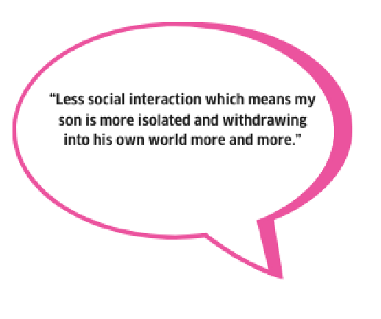
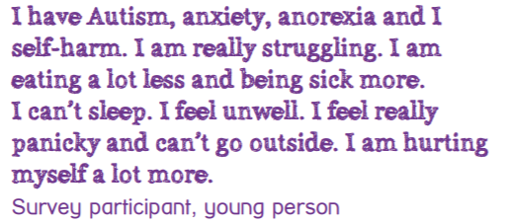
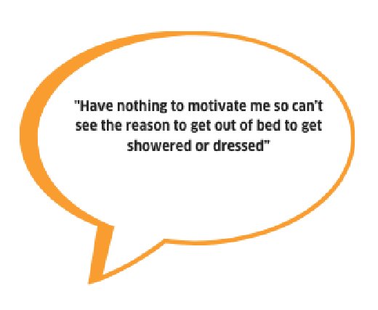
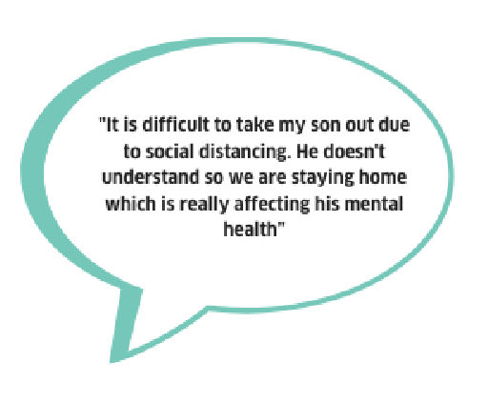
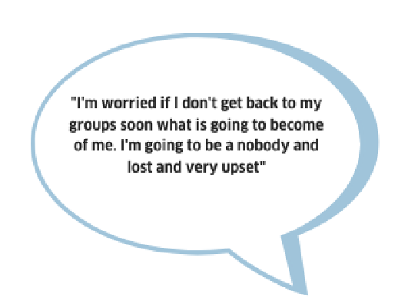
Parent's thoughts…………………
Children and Young People’s thoughts…………..

Slide 5
Young Minds
How to support your child during lockdown – parent tips
Talking to your child about Coronavirus
Starting conversations
Supporting your child with anxiety and anger
Struggling with behaviour
Failing to follow restrictions
Financial support for you and your family
Young Minds.org. Supporting your child during the Coronavirus pandemic. https://youngminds.org.uk/find-help/for-parents/supporting-your-child-during-the-coronavirus-pandemic/

Slide 6
Looking after the rest of the family
Keep routines
Get active
Free time – way from social media
Take 10 minutes to yourself
Don’t expect too much of yourself
Explain to the family what is happening
Keep in touch with friends and family
Reset before bedtime
Focus on POSITIVES
https://youngminds.org.uk/find-help/for-parents/

Slide 7
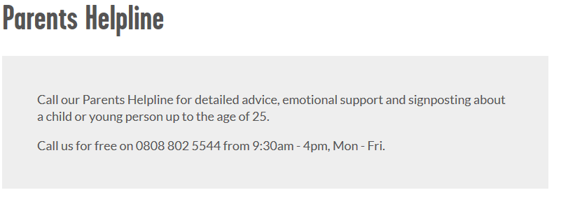
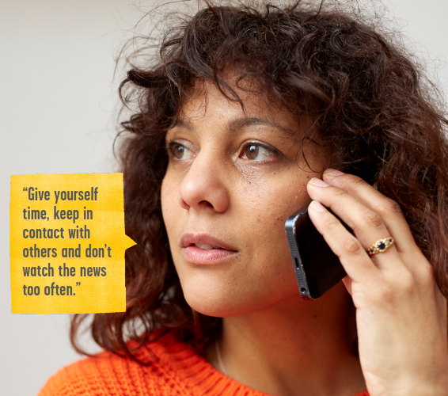
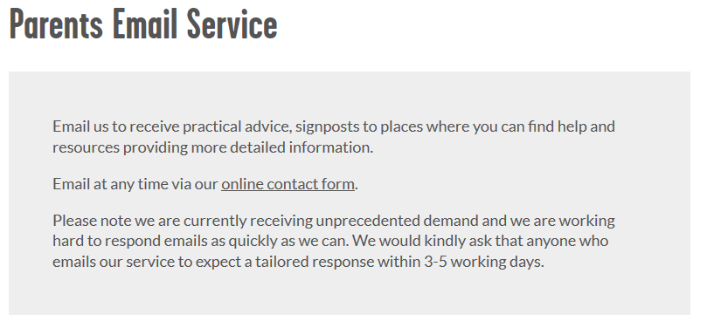
Looking after yourself

Slide 8
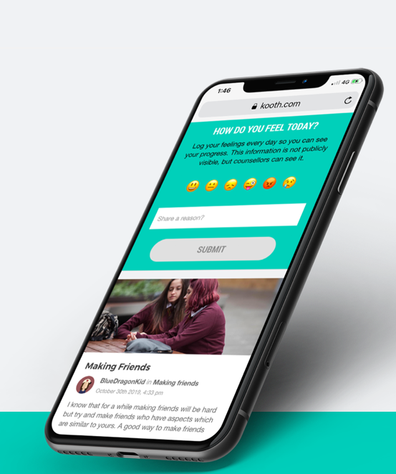
Professional Help
Access to Mental Health Support and Services
Guide to Counselling Services
https://youngminds.org.uk/find-help/for-parents/supporting-your-child-during-the-coronavirus-pandemic/
https://www.kooth.com/

Slide 9
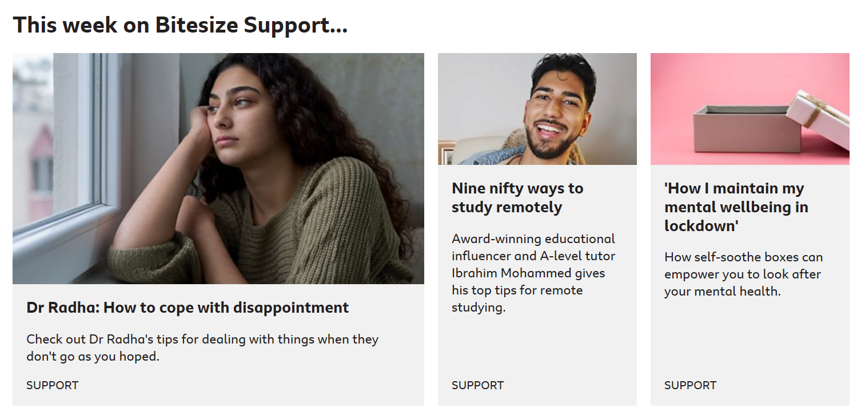
Anna Freud
Podcasts (anxiety, ADHD, Therapy, self-harm, trauma, eating disorders, medication for mental health)
https://www.bbc.co.uk/bitesize/support

Slide 10
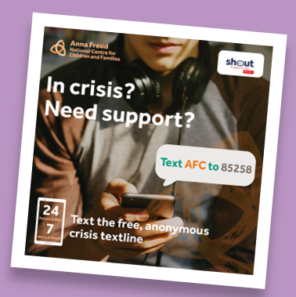
Looking after yourself
Engaging in healthy behaviour e.g. Personal care, exercise, regular sleep, healthy and balanced diet
Asking for help when you need it
Being kind to yourself, putting yourself first
Give yourself permission – its not selfish to think of yourself first for a change and not everyone else
Stay connected – check in with trusted friends
Set healthy boundaries – it’s ok to say no! Have your own voice.
Remember your passions
https://youtu.be/q5viyKoCikI

Slide 11
Useful links
https://www.teachitprimary.co.uk/resources/f/wellbeing-primary/10-ways-to-find-support-with-children-and-young-people-s-mental-health/36485

Slide 12
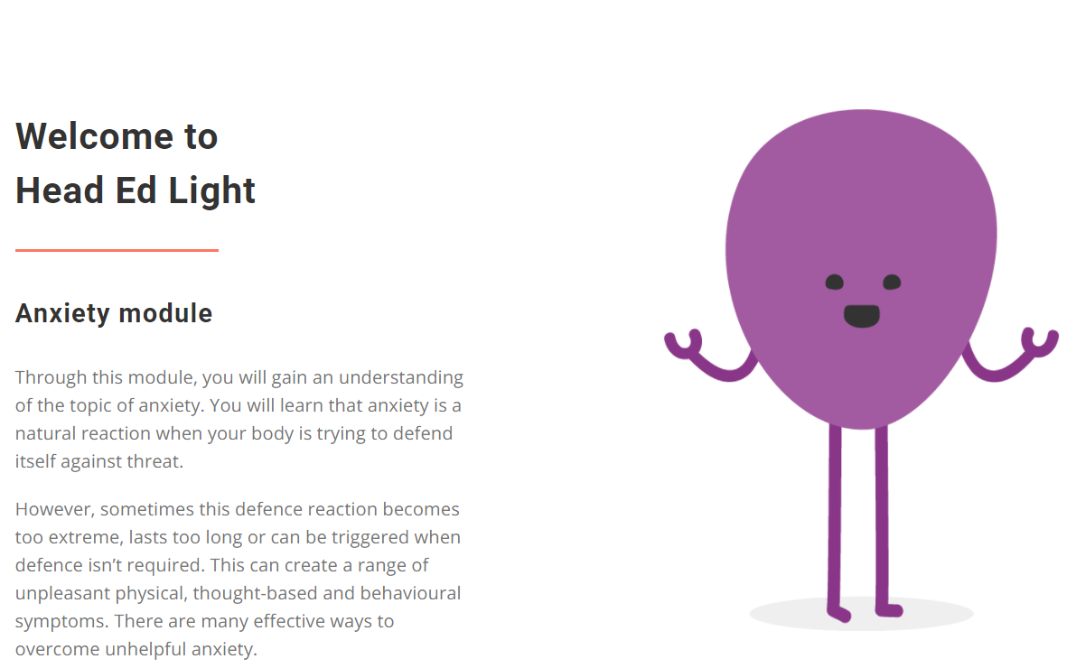
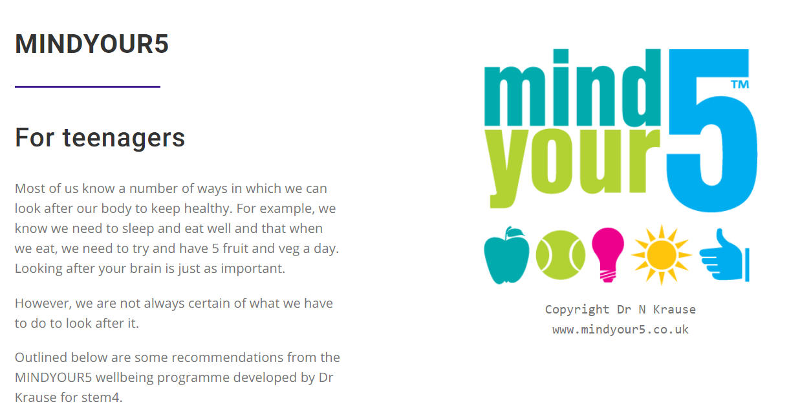
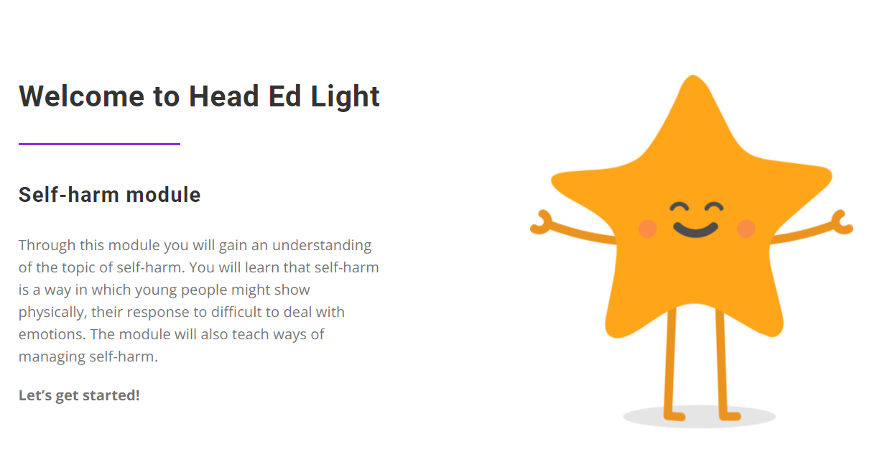
stem4

Slide 13
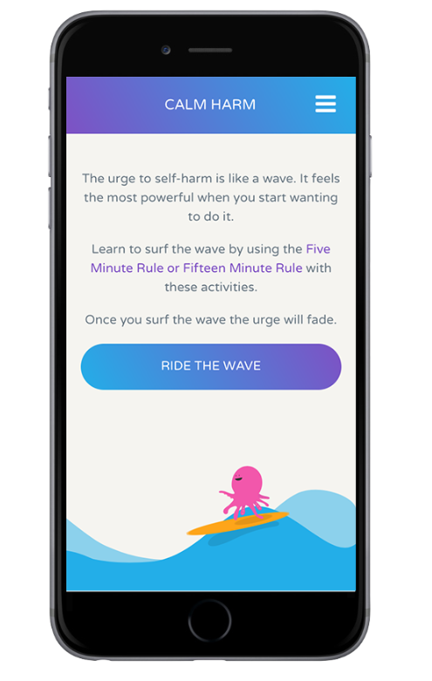
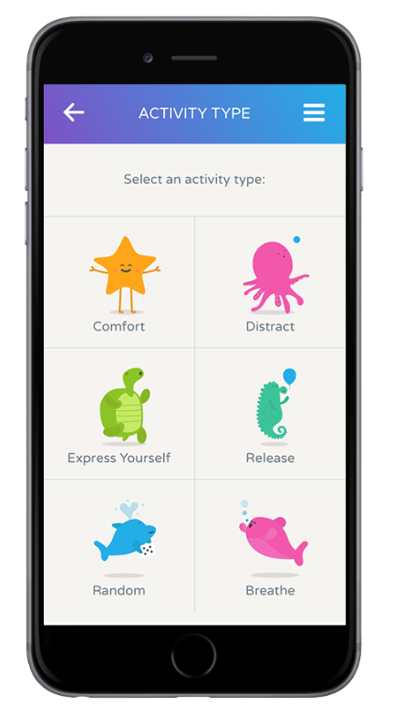
App – Calm Harm
An award-winning app developed for teenage mental health charity stem4.
Provides tasks to help resist or manage the urge to self-harm
Make it private by setting a password
Track progress and notice change

Slide 14
Mindfulness
https://www.learnful.co.uk/monday-midday-mindfulness/?fbclid=IwAR1GI36ZvaNqwlCH4TApqvPl_JdcLzyHu5vOHF3Qc45YZWqHwpnFVD1Uots

Slide 15
Mindful moments…………..
Stop
Close your eyes
Notice what is around you
What can you hear?
What can you smell?
How does the fabric you are wearing feel on your skin?
Open your eyes – notice your surroundings
Write down two things you see
https://www.bbc.co.uk/programmes/p08gqsz3
BBC Spring Watch
https://www.bbc.co.uk/programmes/p06pmfx6
BBC Mindful Moments

Slide 16
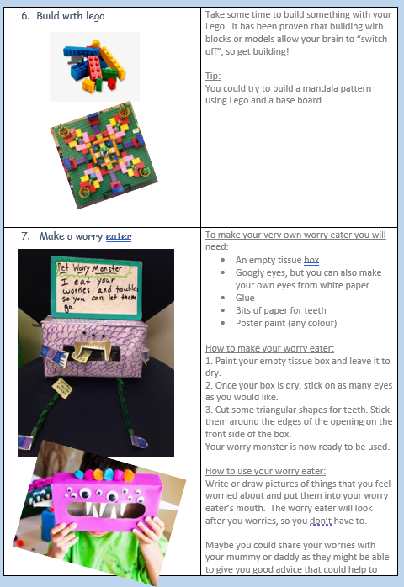
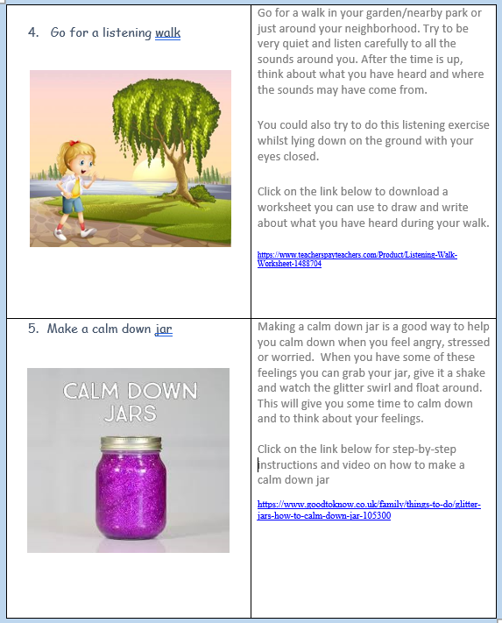
Mindfulness Menu ………… try 3 new activities every week (18 ideas)

Slide 17
Coping with ‘remote learning’
Create a ‘learning space’
Make a schedule – stick to it
Reduce distractions
Take regular breaks / get exercise
Keep communicating
Get social
Ask for help
Celebrate the wins
Help kids manage their stress
Don’t take it out on the kids

Slide 18
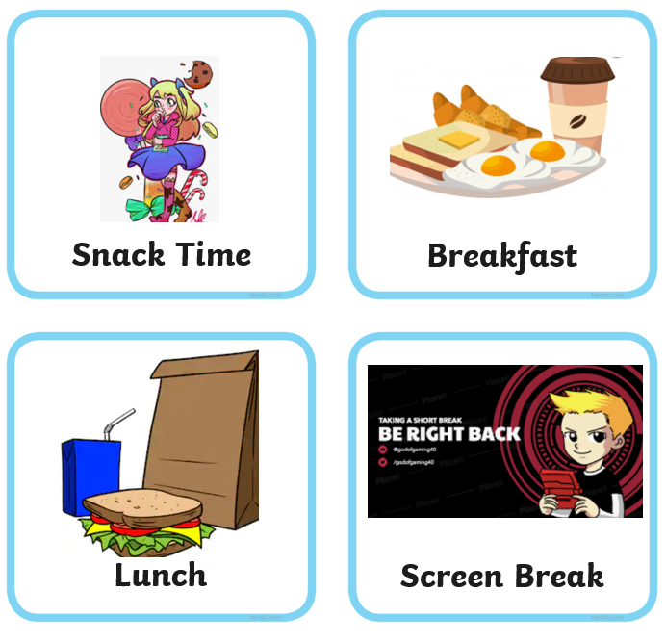
Planning your days at home during lockdown Visual Timetable

Slide 19
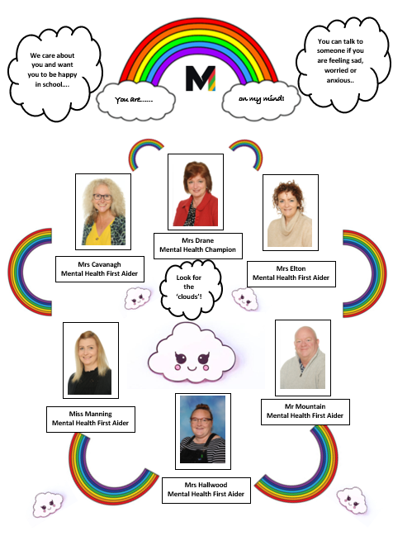
You are on my mind!
Meet the team
Mental Health Champion / Mental Health ‘First Aiders’
Identifying needs
Support for wellbeing
PSHE
Signposting
Mental Health Policy & supporting documents
Support for parents
Outside agencies
Look for the ‘clouds’!

Slide 20
Positives………………………….
‘Your anxieties and fears are not you … and they do not have to rule your life’ …….
Jon Kabat-Zinn
‘You can’t stop the waves, but you can learn to surf’……
Jon Kabat-Zinn
‘We could never learn to be brave and patient if there were only joy in the world’ …….
Helen Keller

Slide 21
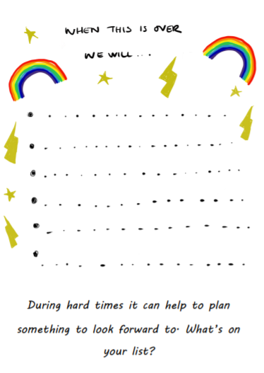
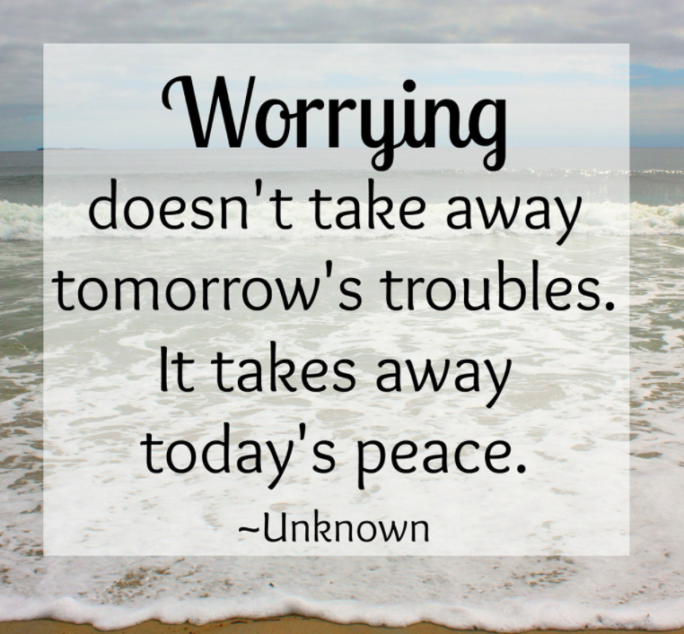
‘Keep your face always towards the sunshine, and shadows will fall behind you’ …….
Walt Whitman

Slide 22
We all have mental health, and everyone has a part to play in supporting Children and Young People’s mental health and keeping them safe.
https://learn.nes.nhs.scot/33734/mental-health-improvement-and-prevention-of-self-harm-and-suicide/informed-level-resources

Slide 23
Newsletter

Slide 24
Promoting Positive Mental Health at Marshfields
Designated webpage for Mental Health
Contact details of staff who can offer support
Links for help, advice and support
Newsletter
Up to date information
Training (including a copy of this PowerPoint for future reference
Links to Mental Health Policy
Children’s Mental Health Week (1st – 7th February)
Mental Health training for all staff
Connected Communities project
Therapeutic Interventions
Governor with oversight for MH
Student MH advocates

Slide 25
Further advice
GENERAL HELPLINES
Childline | 0800 111 (free) | You can talk to us about anything. No problem is too big or too small. Call us free on 0800 1111 or get in touch online. However you choose to contact us, you’re in control. It's confidential and you don't have to give your name if you don't want to. https://www.childline.org.uk/
Samaritans | Call 116 123 (free 24 hours) Email jo@samaritans.org (Response time: 24 hours) | If you need someone to talk to, we listen. We won't judge or tell you what to do. https://www.samaritans.org/
The Mix | Call 0800 068 4141 Text 07860 039967 Email pat@papyrus-uk.org 9am - 10pm weekdays, 2pm - 10pm weekends, 2pm - 10pm bank holidays | If you are having thoughts of suicide or are concerned for a young person who might be you can contact HOPELINEUK for confidential support and practical advice. https://www.themix.org.uk/
Parentline/YoungMinds | 0808 802 5544 (free Mon-Fri from 9.30am to 4pm) | Our Parents Helpline is available to offer advice to parents and carers worried about a child or young person under 25. https://youngminds.org.uk/
Shout | Text Shout to 85258 https://giveusashout.org/ | Shout is a free 24/7 text service for anyone in crisis anytime, anywhere. It's a place to go if you're struggling to cope and you need immediate help.
ONLINE COUNSELLING
Kooth | https://www.kooth.com/ | Free, safe and anonymous online support for young people.
Togetherall (formerly Big White Wall) | https://togetherall.com/en-gb/ | Togetherall is an online community for people who are stressed, anxious or feeling low. The service has an active forum with round-the-clock support from trained professionals. You can talk anonymously to other members and take part in group or one-to-one therapy with therapists.
FACE-TO-FACE
NHS | https://www.nhs.uk/using-the-nhs/nhs-services/mental-health-services/how-to-access-mental-health-services/ | The NHS website provides information on how to access mental health services in the UK. This website covers free mental health services, GP referrals, self-referrals, and signposting for employers, child and adolescent mental health services (CAMHS) and the NHS mental health helpline.
MENTAL HEALTH INFORMATION
NHS Inform | https://www.nhsinform.scot/ | NHS inform is a platform which provides information and guidance on a range of mental health disorders.
NHS Moodzone | https://www.nhs.uk/conditions/stress-anxiety-depression/ | NHS Moodzone offers practical advice, interactive tools, videos and audio guides to help you feel mentaly and emotionally better, including a mood self-assessment quiz.
Every Mind Matters | https://www.nhs.uk/oneyou/every-mind-matters | NHS and Public Health England have developed a five-step quiz which provides users with top tips and advice tailored for their personal needs.

Slide 26
Further advice
MENTAL HEALTH INFORMATION
Mind | Mind Infoline: Call 0300 123 3393 or text 86463 9am - 6pm Mon-Fri (except for Bank Holidays) | Provides information on a range of topics including: Types of mental health problems; Where to get help; Advocacy; Medication and alternative treatments; Will look for details of help and support in your own area. https://www.mind.org.uk/
Rethink Mental Illness | https://www.rethink.org/ | Improves the lives of people severely affected by mental illness through our network of local groups and services, expert information and successful campaigning.
YoungMinds | https://youngminds.org.uk/ | Whether you want to know more about how you're feeling, get information about a mental health condition or know what support is available to you, our guides can help.
ANXIETY
Anxiety UK | Infoline: 03444 775 774 (Mon - Fri, 9.30am to 5.30pm) Text Service: 07537 416 905 | Charity providing support if you have been diagnosed with an anxiety condition. https://www.anxietyuk.org.uk/
Anxiety Care UK | anxietycare.org.uk | Anxiety Care UK is a Community Organisation based in Redbridge, East London, run by trained volunteer Recovery Support Workers. We provide a variety of services, helping people to recover from anxiety. We hope that through our Recovery Groups, Workshops, Email, Counselling, E-Counselling and Outreach Services, together with a range of literature, we can help you to understand anxiety and guide you towards recovery.
No Panic | Youth Helpline 0330 606 1174 for 13–20-year-olds Everyday 10am - 10pm Charge: 5p a minute + your access charge Email: sarah@nopanic.org.uk | No Panic is a registered charity which helps people who suffer from Panic Attacks, Phobias, Obsessive Compulsive Disorders and other related anxiety disorders including those people who are trying to give up tranquillizers. No Panic also provides support for the carers of people who suffer from anxiety disorders.
SELF-HARM
Harmless | https://harmless.org.uk/ | Harmless is a user-led organisation that provides a range of services about self-harm and suicide prevention including support, information, training and consultancy to people who self-harm, their friends and families and professionals and those at risk of suicide.
NSHN | https://www.nshn.co.uk/ | The forum provides crisis support, information and resources, advice, discussions and distractions.
EATING DISORDERS
Beat | Helpline 0808 801 0677 Youthline 0808 801 0711 Studentline 0808 801 0811 Open 365 days a year from 12pm - 8pm during the week, and 4pm - 8pm on weekends and Bank Holidays. | Beat provides helplines for adults and young people offering support and information about eating disorders. These helplines are free to call from all phones. https://www.beateatingdisorders.org.uk/
Syeda |  | Syeda is the South Yorkshire Eating Disorders Association and is a support service for those with eating disorders and their carers. https://www.syeda.org.uk/

Slide 27
Further advice
GENERAL HELPLINES
Gingerbread | Phone: 0808 802 0925 Opening times: 10am - 6pm, Mondays; 10am - 1pm and 5 - 7pm, Wednesdays; 10am - 4pm, Tuesdays, Thursdays and Fridays | Provides support and advice for single parents in England and Wales. https://www.gingerbread.org.uk/
Family Line | Phone: 0808 802 6666 Text: 07537 404 282 Email: familyline@family-action.org.uk Opening times: 9am - 9pm, Monday - Friday | Provides information and support around family issues, as well as longer-term help through Befrienders and Counsellors. https://www.family-action.org.uk/what-we-do/children-families/familyline/
ChatHealth | TEXT 07480 635 443 to start a conversation | ChatHealth (Cambridgeshire and Peterborough) provides an alternative way for young people to engage with school nurses on topics including relationship advice, healthy eating, smoking cessation, bullying and exam stress.

Slide 28
References
Young Minds.org. The Mental Health Emergency. How has the coronavirus pandemic impacted on our mental health. https://www.mind.org.uk/media-a/5929/the-mental-health-emergency_a4_final.pdf?
SCLD (June, 2020). The Impact of Coronavirus on People with Learning Disabilties and their Parents, Carers and Supporters. https://www.scld.org.uk/wp-content/uploads/2020/06/SCLD-Coronavirus-Report-FINAL.pdf
Young Minds.org. Supporting your child during the Coronavirus pandemic. https://youngminds.org.uk/find-help/for-parents/supporting-your-child-during-the-coronavirus-pandemic/
Kooth. Your online mental health community. https://www.kooth.com/
Anna Freud (National Centre for Children and Families). https://www.annafreud.org/parents-and-carers/
NSPCC. Supporting Children & Young People’s Mental Health. https://learning.nspcc.org.uk/news/2020/april/supporting-children-young-people-mental-health
The very well family. How parents can deal with the stress of virtual education. https://www.verywellfamily.com/how-parents-can-deal-with-the-stress-of-virtual-education-5077955
Stem4. Supporting positive mental health in teenagers. https://stem4.org.uk/
Sweet, C. (2017). The Anxiety Journal. London:Boxtree
Turus Learn (2021). Mental Health Improvement, and prevention of self-harm and suicide. https://learn.nes.nhs.scot/33734/mental-health-improvement-and-prevention-of-self-harm-and-suicide/informed-level-resources

Slide 29
Any questions, or if you feel you need help and support with any issues you or your family may have, please do not hesitate to get in contact
office@marshfields-sch.co.uk
debbiedrane@marshfields-sch.co.uk

